Slide 1
Current version of DEBkiss model
 | Initial parameters | Parameters estimated from ODE | Notes AIC = 457.44 (compared to 591.5 with fitting turned off) Negative log likelihood = 225.72 (compared to 294.8 with fitting turned off) Data used: -Total length over time -Cumulative reproduction over time -Survival over time (early life only) Comments -Predicted length never plateaus (maybe ok) -Time to hatching is a little long (18d, should be ~6d), which causes hatch survival to be on the low end too.
delM | 0.1066 (data) | -
dV | 0.1 | -
sJAm | 0.27 | 0.1321
sJM | 0.015 | 0.006401
WB0 | 0.1 | -
Lwp | 120 (data) | -
yAV | 0.8 | -
yBA | 0.95 | -
yVA | 0.2 | -
kappa | 0.75 | 0.8349
f | 1 (ad libitum) | -
fB | 0.5 | -
Lwf | 0 | -
mu_emb | 0.05 | -
mu_lar | 0.01 | -

Slide 2
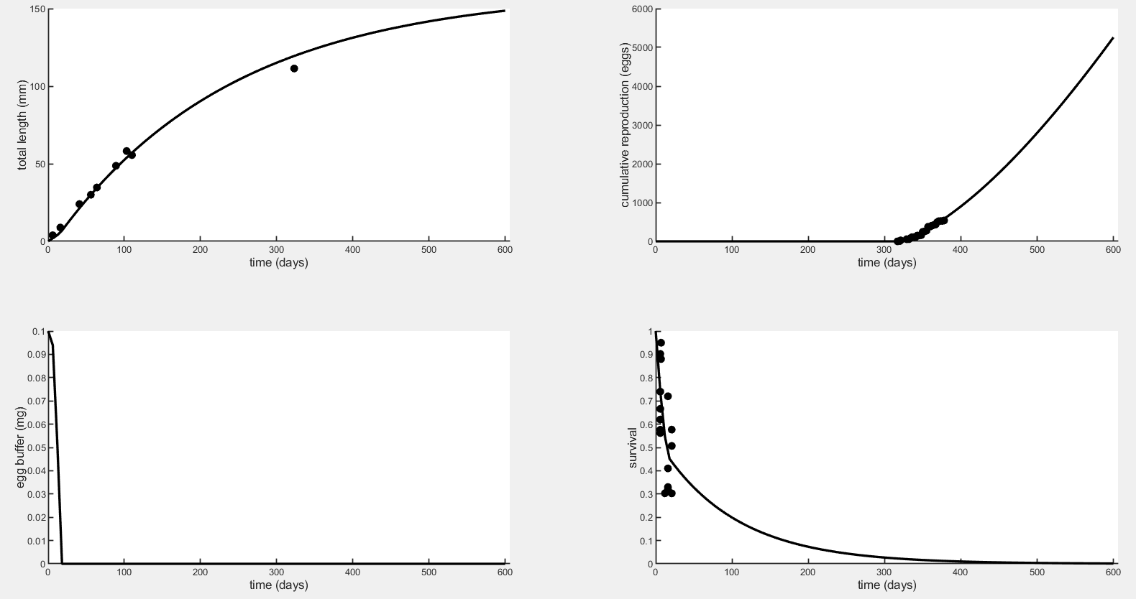
Current version of DEBkiss model

Slide 3
Fitting for one parameter at a time, recording the estimate, AIC, and NLL below.
 | Initial parameters | Parameters estimated from ODE | AIC | Negative Log-Likelihood | Notes
delM | 0.1066 (data) | -
dV | 0.1 | -
sJAm | 0.27 | 0.2683 | 532.23 | 265.12 | Repro improved
sJM | 0.015 | 0.01511 | 533.29 | 265.65 | Repro improved
WB0 | 0.1 | 0.1482 | 551.03 | 274.51 | Repro dif
Lwp | 120 (data) | 120.8 | 531.58 | 264.79 | Repro improved
yAV | 0.8 | 0.9998 | 591.49 | 294.74 | Nothing changed
yBA | 0.95 | 0.6412 | 551.03 | 274.51 | Repro dif like WB0
yVA | 0.2 | 0.1896 | 520.85 | 259.42 | Repro improved
kappa | 0.75 | 0.7451 | 530.74 | 264.37 | Repro improved
f | 1 (ad libitum) | 0.9938 | 532.37 | 265.18 | Repro improved
fB | 0.5 | 0.1693 | 509.70 | 253.85 | Hatching delayed
Lwf | 0 | 0.0002625 | 591.50 | 294.75 | Nothing changed
mu_emb | 0.05 | 0.06766 | 588.64 | 293.32 | Hatch surv lower
mu_lar | 0.01 | 0.03999 | 586.20 | 292.10 | Larval surv lower
For reference: with no fitting or parameter estimation, only ‘manual’ fitting (selection of initial parameters): NLL=294.752 (AIC not stated but I guess it is 591.504).

Slide 4
Fitting for one parameter at a time, recording the estimate, AIC, and NLL below.
Here are the same parameters and AIC values but listed in order of lowest AIC (best fit, greatest improvement from version with fitting turned off) to highest:
Parameter | AIC | Notes
fB | 509.70 | Hatching delayed unrealistically, maybe because no hatching data
yVA | 520.85 | Repro improved (shifted earlier but similar slope)
kappa | 530.74 | Repro improved (shifted earlier but similar slope)
Lwp | 531.58 | Repro improved (shifted earlier but similar slope)
sJAm | 532.23 | Repro improved (shifted earlier but similar slope)
f | 532.37 | Repro improved, but does it make sense to leave it free?
sJM | 533.29 | Repro improved (shifted earlier but similar slope)
WB0 | 551.03 | Repro improved but not as close a fit as others, slope dif
yBA | 551.03 | Repro improved but not as close a fit as others (looks same as WB0)
mu_lar | 586.20 | Larval survival is lower, approaches zero too soon but doesn’t touch it
mu_emb | 588.64 | Survival to hatch is lower
yAV | 591.49 | Nothing visibly changed, doesn’t make sense to use starvation param
Lwf | 591.50 | Nothing changed
For reference: with no fitting or parameter estimation, only ‘manual’ fitting (selection of initial parameters): NLL=294.752 (AIC not stated but I guess it is 591.504).

Slide 5
Using the most influential parameters, fitting for combinations of two
fB led to best fits when combined with sJAm or sJM (AIC=476) but unrealistic hatch times, may be because there is no data for egg buffer.
Next best were sJAm and sJM (AIC=485.98), yVA and kappa (AIC=491.61), yVA and sJM (AIC=494.05), and yVA and sJAm (AIC=494.59).
Didn’t include Lwp or f in this exercise because they are known values (length at puberty comes from literature and ad libitum food f=1).
There is a table of all combinations (not included here) if we want to look at this more.

Slide 6
Using the most influential parameters, fitting for combinations of three
 | Initial parameters | Parameters estimated from ODE | AIC | Negative Log-Likelihood | Notes
sJAm | 0.27 | 0.08945 | 458.00 | 226.00 | These are very far off from initial; length increasing too much maybe.
sJM | 0.015 | 0.003931
yVA | 0.2 | 0.3332
sJAm | 0.27 | 0.2834 | 457.62 | 225.81 | Length increases too much maybe, doesn’t plateau.
yVA | 0.2 | 0.08216
kappa | 0.75 | 0.9260
sJM | 0.015 | 0.01468 | 463.33 | 228.67 | Length keeps increasing, doesn’t plateau.
yVA | 0.2 | 0.09255
kappa | 0.75 | 0.9069
sJAm | 0.27 | 0.1321 | 457.44 | 225.72 | Pretty far off from initial parameters; length doesn’t plateau. Hatching is delayed.
sJM | 0.015 | 0.006401
kappa | 0.75 | 0.8349
Best combination (lowest AIC) is sJAm, sJM, and kappa.
Hatching is delayed to 12-18d in all versions and length keeps increasing.
Does length need to plateau after ~400 to 500 days? Since they die before their second year can we allow growth to keep going up beyond their life span because that part doesn’t matter and we don’t really know whether it would plateau or be indeterminate? The part during their lifespan isn’t unrealistic. See next slide for plots from sJAm, sJM, kappa fitting.

Slide 7
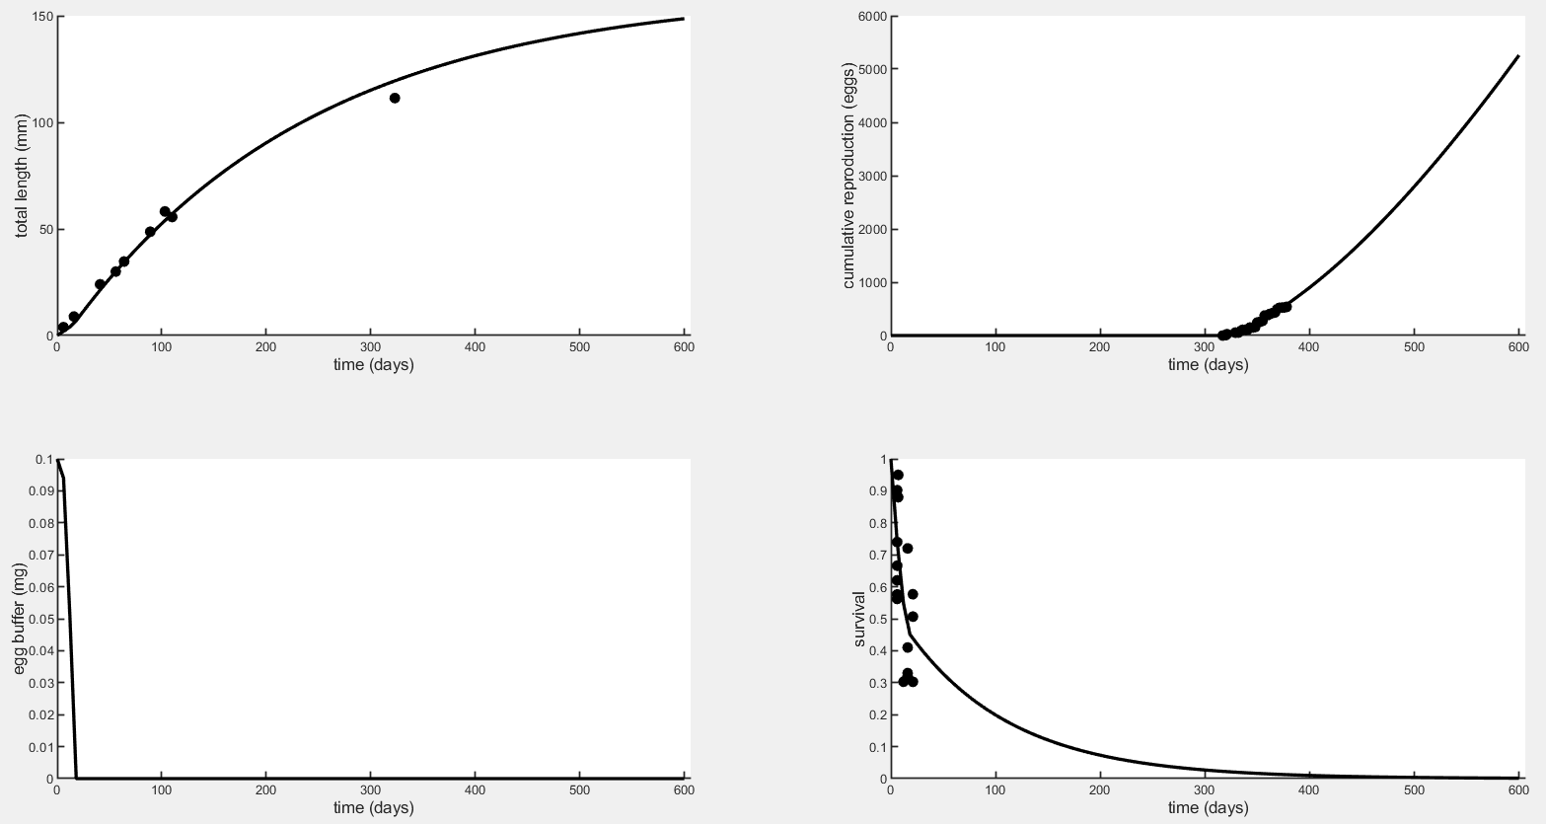
Best combination (lowest AIC) is sJAm, sJM, and kappa.

Slide 8
Other updates
Started writing Methods
Finished draft of Chapter 2 – Effects of high pCO₂ on metabolic response to hypoxia (need for DEBkiss model). Janet is giving comments this month.

Slide 9
Hypoxia effects on metabolism
P_{crit} by stage (ambient CO₂ group, no acidification):
Embryo: 2.044(±0.209) mg/L
2 days-post-hatch: 1.653(±0.154) mg/L
5 days-post-hatch: 1.561(±0.183) mg/L
Some embryos had no identifiable P_{crit}, fully oxygen-dependent (or oxyconforming)
Many individuals, especially larvae, showed a brief spike in oxygen consumption at very low O₂, likely due to stimulatory effects of anaerobic byproducts building up (lactate, etc.)

Slide 10
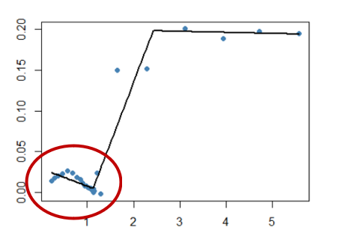
 |  | Ambient pCO₂ | Moderate pCO₂ | High pCO₂
Embryos | Exp. 1 (24°C) | 10% | 22.22% | 11.11%
 | Exp. 2 (22°C) | 18.18% | 16.67% | 35.71%
2dph Larvae | Exp. 1 (24°C) | 100% | 90% | 77.78%
 | Exp. 2 (22°C) | 66.67% | 83.33% | 53.85%
5dph Larvae | Exp. 1 (24°C) | 55.55% | 37.5% | 33.33%
 | Exp. 2 (22°C) | 85.71% | 40% | 75%
Oxygen consumption sometimes peaked in low oxygen, possibly due to stimulation from lactate buildup.
Embryos were often oxyconforming for entire trial (<5 mg/L).

Slide 11
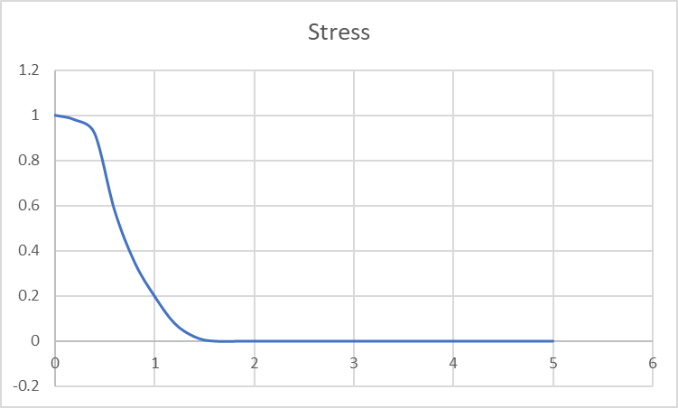
Asymmetric curve for additional stress at very low oxygen
Steeper increase in stress to near maximum when the low-oxygen MO2 spike occurs (red arrow).
This brings stress near the maximum until oxygen reaches zero.
Asymmetric logistic or sigmoid curve (e.g. shape of allosteric sigmoid function)
OR could have two stress functions, each to a different parameter and representing a different source of stress (being below Pcrit vs. having lactate accumulate).

Slide 12
Next steps
Write methods (so far) – 1 week
Modify code to include a stress function controlled by hypoxia – 1-2 weeks

